Slide 1
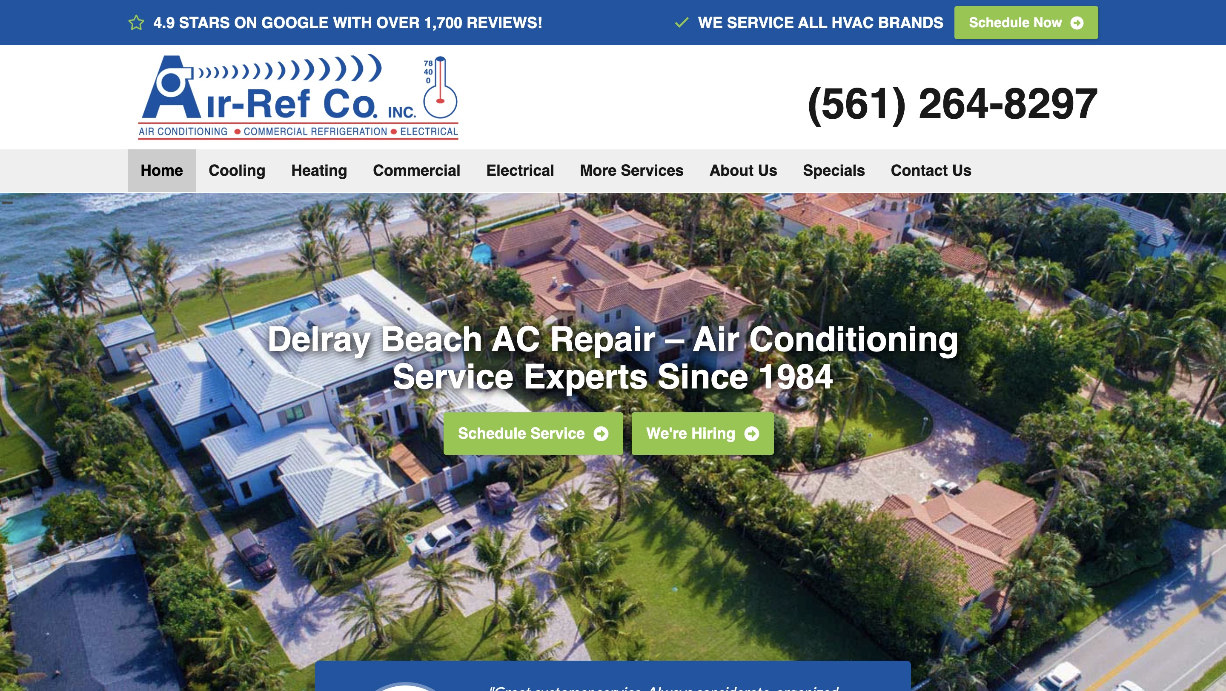
AIR-REF · WEBSITE CONVERSATION
A clearer path from interest to inquiry
What I noticed
The current site is modern and has scheduling actions. This is a targeted replacement-page experiment, not a case for replacing the whole site.
Current website · desktop capture
Private discussion concept · Ravi Mehta · 17 October 2026
01
Notes:
Observed website screenshot captured October17,2026. https://airref.com/
https://airref.com/
The reviewed homepage directs several different service needs toward general scheduling; no material website defect was established.
No form or conversion failure claimed. Existing SEO and marketing vendor unknown. Sources: https://airref.com/
https://airref.com/contact-us/
https://airref.com/about-us/
https://www.bestpickreports.com/air-conditioning-and-heating/south-florida/air-ref-co-inc

Slide 2
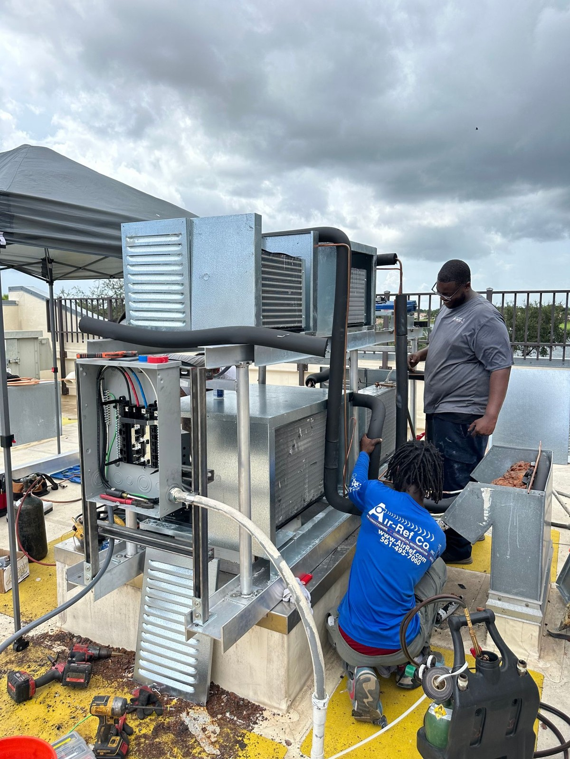
AIR-REF · PROPOSED DIRECTION
A small concept, built around your business
Plan for comfort.
Know your options.
A focused starting point for homeowners considering a replacement air-conditioning system in Delray Beach.
Explore my next system →
Published business imagery + proposed copy · Open the interactive homepage concept from the pack
Private discussion concept · Ravi Mehta · 17 October 2026
02
Notes:
Independent private homepage concept. Not a complete production website. Forms neither send nor store data. Source assets: https://airref.com/. No client endorsement implied. Local demo folder: air-ref. Opportunity: Explore a separate replacement or commercial-project inquiry page only if the existing scheduling process leaves a measurable gap.

Slide 3
AIR-REF · SEARCH DISCUSSION
Search evidence and a focused starting point
OBSERVED IN AHREFS
THREE IDEAS TO VALIDATE
#1
air ref delray beach
AC replacement Delray Beach
Last checked 2026-08-28
#1
how to remove moisture from room in rainy season
commercial HVAC Delray Beach
Last checked 2026-09-24
#1
air ref co delray beach
ductless AC installation Boca Raton
Last checked 2026-10-08
Choose by service fit, profit potential and capacity—not ranking alone.
US organic database; selected best positions. Not a live local map grid or AI-search ranking report.
Private discussion concept · Ravi Mehta · 17 October 2026
03
Notes:
Ahrefs Site Explorer organic keywords: target airref.com, US, date2026-10-17, limit5, orderbest_positionasc. Sample and dated rows stored in ahrefs.json. Ahrefs reports position 1 for several Air-Ref brand searches and an informational humidity query; these results demonstrate existing visibility but do not measure replacement or commercial lead performance.
Keyword ideas are hypotheses, not verified demand or measured ranks. Map/AI visibility not measured. No improvement guarantee.

Slide 4
REPUTABLE SEO MARKETING · PUBLISHED CASE STUDY
A separate example of what measured work can do
MONTHLY WEBSITE INQUIRIES
An unnamed pool remodeler
Reputable SEO Marketing reports growth from 1 to 28 monthly website inquiries over six months.
The engagement included website redesign, SEO and a separate social campaign. This is the agency’s reported result, not a forecast for your business.
Source: reputableseomarketing.com · Calendar dates and underlying analytics are not supplied.
Private discussion concept · Ravi Mehta · 17 October 2026
04
Notes:
Source https://reputableseomarketing.com/ , CaseStudy1, accessedOctober17,2026. Published agency self-report, not independently audited. Anonymous client; no verified calendar dates. Numbers:1 and28 website inquiries per month after6months. Separate social15leads not included. Do not imply solely SEO attribution, own Ravi result, guaranteed prospect result or client identity. Confirm approved current evidence with Danny before using as a verified partner case. Draft request is included in pack. Ravi website portfolio: https://www.builderseastfl.com/ — design/build proof, no validated SEO lift claimed.

Slide 5
AIR-REF · NEXT CONVERSATION
Start with the work you actually want more of.
Is there a particular project type you want more of that the current scheduling flow does not distinguish well?
A focused project, quoted after discovery
Relevant work to review
Agree on the service, geography, inquiry quality and available capacity. Then define the website or search work, tracking and review date.
Builder’s East
builderseastfl.com
Ravi’s web-development portfolio. SEO outcomes are separate and must be supported by their own evidence.
Private discussion concept · Ravi Mehta · 17 October 2026
05
Notes:
Your site already explains your services well. I’d only suggest a focused replacement or commercial inquiry test if it solves a gap your team actually sees.
Is there a particular project type you want more of that the current scheduling flow does not distinguish well?
Explore a separate replacement or commercial-project inquiry page only if the existing scheduling process leaves a measurable gap.
Proposed $500 scope is seller offer, not buyer budget or consent. No promises of leads or rankings. Build only after agreement and approval of business details. SEO decision: estimate contribution per job, close rate, capacity and acceptable acquisition cost; gross revenue is not profit. Public portfolio https://www.builderseastfl.com/ .

