Slide 1
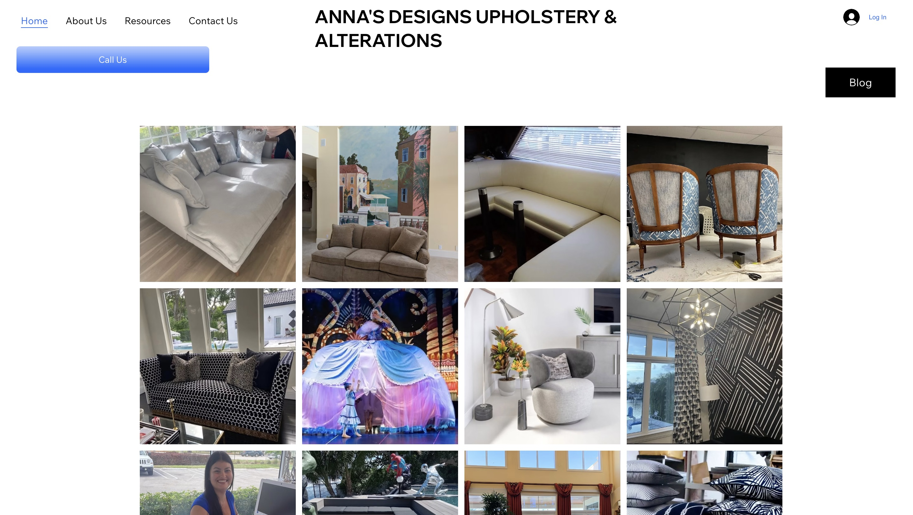
ANNA’S DESIGNS · WEBSITE CONVERSATION
A clearer path from interest to inquiry
What I noticed
The opening shows furniture photographs, but leaves the service story largely unstated. Lead with what you restore and how someone can discuss a piece.
Current website · desktop capture
Private discussion concept · Ravi Mehta · 17 October 2026
01
Notes:
Observed website screenshot captured October17,2026. https://www.annasdesignupholstery.net/
https://www.annasdesignupholstery.net/
The reviewed homepage source still contains unfinished template details, including a generic business-name footer and placeholder contact link.
No form or conversion failure claimed. Existing SEO and marketing vendor unknown. Sources: https://www.annasdesignupholstery.net/
https://www.annasdesignupholstery.net/blank-2
https://nextdoor.com/pages/annadsign-marine-canvas-upholstery-boca-raton-fl/
https://annas-designsupholstery.localo.site/

Slide 2
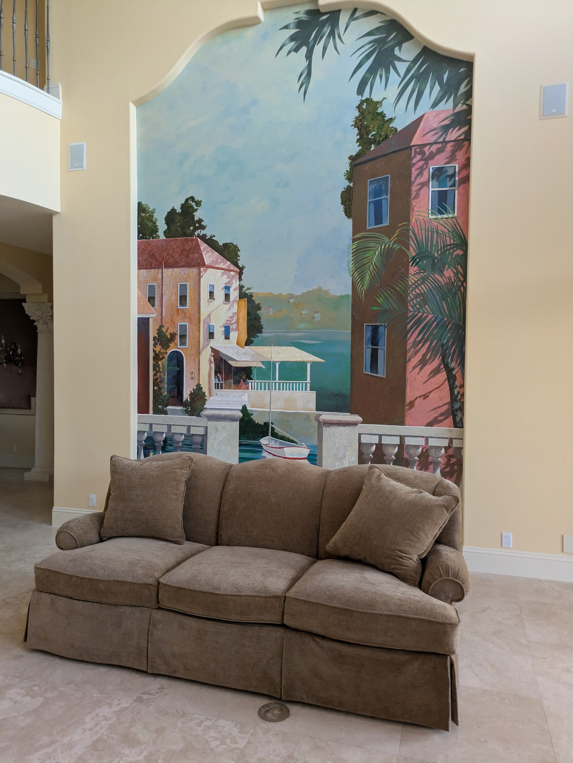
ANNA’S DESIGNS · PROPOSED DIRECTION
A small concept, built around your business
A familiar piece.
A new chapter.
Upholstery and alterations in Boca Raton. Explore a fresh fabric, restore a favorite shape, or talk through a piece worth keeping.
Talk about your piece →
Published business imagery + proposed copy · Open the interactive homepage concept from the pack
Private discussion concept · Ravi Mehta · 17 October 2026
02
Notes:
Independent private homepage concept. Not a complete production website. Forms neither send nor store data. Source assets: https://www.annasdesignupholstery.net/. No client endorsement implied. Local demo folder: annas-upholstery. Opportunity: Turn the site into a clear upholstery portfolio with real project photos and a simple request for an estimate.

Slide 3
ANNA’S DESIGNS · SEARCH DISCUSSION
Search evidence and a focused starting point
OBSERVED IN AHREFS
THREE IDEAS TO VALIDATE
No keywords returned
in this small sample.
upholstery Boca Raton
boat upholstery Boca Raton
That is not proof of no rankings or traffic. Verify a local baseline before proposing an SEO scope.
custom cushions Boca Raton
Choose by service fit, profit potential and capacity—not ranking alone.
US organic database; selected best positions. Not a live local map grid or AI-search ranking report.
Private discussion concept · Ravi Mehta · 17 October 2026
03
Notes:
Ahrefs Site Explorer organic keywords: target www.annasdesignupholstery.net, US, date2026-10-17, limit5, orderbest_positionasc. Sample and dated rows stored in ahrefs.json. No keywords were returned in this limited Ahrefs sample; that is not evidence of zero search visibility, and current local positions remain unverified.
Keyword ideas are hypotheses, not verified demand or measured ranks. Map/AI visibility not measured. No improvement guarantee.

Slide 4
REPUTABLE SEO MARKETING · PUBLISHED CASE STUDY
A separate example of what measured work can do
MONTHLY WEBSITE INQUIRIES
An unnamed pool remodeler
Reputable SEO Marketing reports growth from 1 to 28 monthly website inquiries over six months.
The engagement included website redesign, SEO and a separate social campaign. This is the agency’s reported result, not a forecast for your business.
Source: reputableseomarketing.com · Calendar dates and underlying analytics are not supplied.
Private discussion concept · Ravi Mehta · 17 October 2026
04
Notes:
Source https://reputableseomarketing.com/ , CaseStudy1, accessedOctober17,2026. Published agency self-report, not independently audited. Anonymous client; no verified calendar dates. Numbers:1 and28 website inquiries per month after6months. Separate social15leads not included. Do not imply solely SEO attribution, own Ravi result, guaranteed prospect result or client identity. Confirm approved current evidence with Danny before using as a verified partner case. Draft request is included in pack. Ravi website portfolio: https://www.builderseastfl.com/ — design/build proof, no validated SEO lift claimed.

Slide 5
ANNA’S DESIGNS · NEXT CONVERSATION
Start small. Make the scope clear.
Would you prefer more furniture upholstery, boat upholstery or custom cushion projects?
A $500 starter-page option
Relevant work to review
One responsive page, approved content and imagery, clear call/directions, and one revision. Hosting, domain, paid services and ongoing SEO quoted separately.
Builder’s East
builderseastfl.com
Ravi’s web-development portfolio. SEO outcomes are separate and must be supported by their own evidence.
Private discussion concept · Ravi Mehta · 17 October 2026
05
Notes:
I noticed a few unfinished details on your website and had an idea for showcasing your upholstery work more clearly.
Would you prefer more furniture upholstery, boat upholstery or custom cushion projects?
Turn the site into a clear upholstery portfolio with real project photos and a simple request for an estimate.
Proposed $500 scope is seller offer, not buyer budget or consent. No promises of leads or rankings. Build only after agreement and approval of business details. SEO decision: estimate contribution per job, close rate, capacity and acceptable acquisition cost; gross revenue is not profit. Public portfolio https://www.builderseastfl.com/ .

