Slide 1
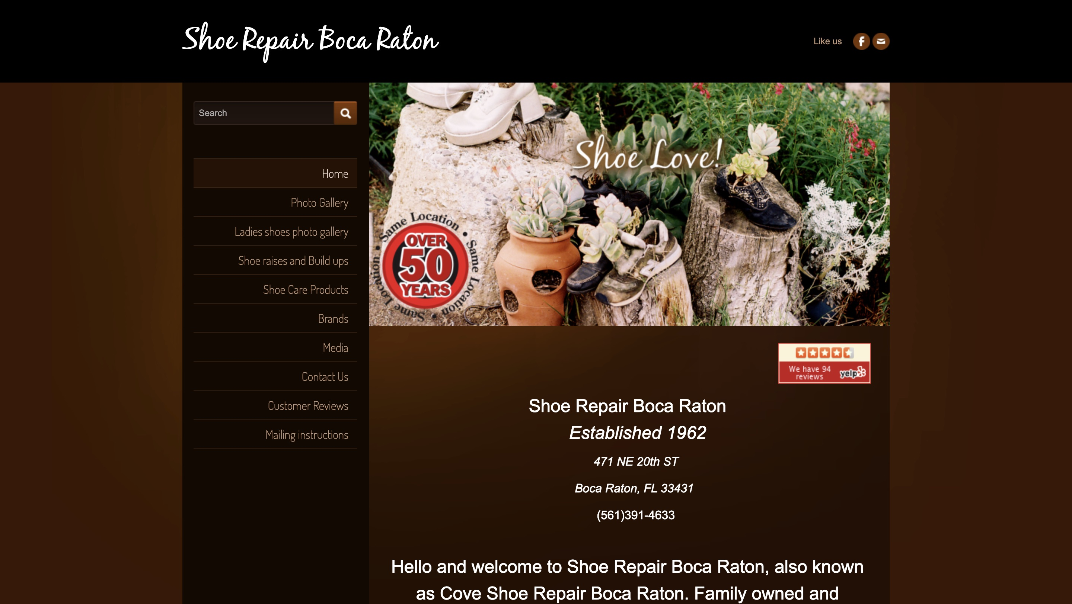
SHOE & LUGGAGE REPAIR OF BOCA · WEBSITE CONVERSATION
A clearer path from interest to inquiry
What I noticed
The narrow page and long navigation compete with the repair story. Make the work, service categories and drop-off details easier to scan.
Current website · desktop capture
Private discussion concept · Ravi Mehta · 17 October 2026
01
Notes:
Observed website screenshot captured October17,2026. https://www.shoerepairbocaraton.com/
https://www.shoerepairbocaraton.com/contact-us.html
The contact page includes a long list of unrelated state and city links after the shop’s contact details.
No form or conversion failure claimed. Existing SEO and marketing vendor unknown. Sources: https://www.shoerepairbocaraton.com/
https://www.shoerepairbocaraton.com/contact-us.html
https://www.loc8nearme.com/florida/boca-raton/cove-shoe-repair-boca-raton/5033588/
https://boca.guide/item/shoe-luggage-repair-of-boca/

Slide 2
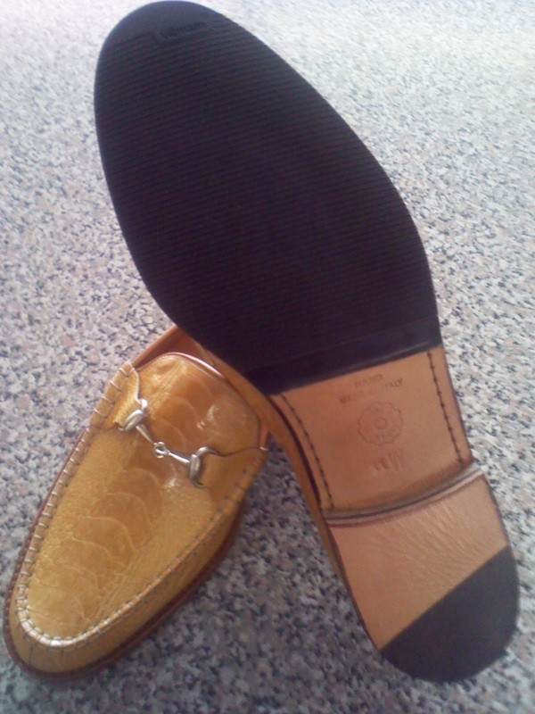
SHOE & LUGGAGE REPAIR OF BOCA · PROPOSED DIRECTION
A small concept, built around your business
Keep the things
you love.
Shoes, handbags and luggage deserve another chapter. Bring your repair to our Boca Raton shop and talk through the possibilities.
Plan your drop-off →
Published business imagery + proposed copy · Open the interactive homepage concept from the pack
Private discussion concept · Ravi Mehta · 17 October 2026
02
Notes:
Independent private homepage concept. Not a complete production website. Forms neither send nor store data. Source assets: https://www.shoerepairbocaraton.com/. No client endorsement implied. Local demo folder: cove-shoe-repair. Opportunity: Give local customers a clearer repair-and-drop-off page, with approved before-and-after work and a direct contact action.

Slide 3
SHOE & LUGGAGE REPAIR OF BOCA · SEARCH DISCUSSION
Search evidence and a focused starting point
OBSERVED IN AHREFS
THREE IDEAS TO VALIDATE
#9
shoe repair delray beach fl
shoe repair Boca Raton
Last checked 2026-09-15
handbag repair Boca Raton
luggage repair Boca Raton
Choose by service fit, profit potential and capacity—not ranking alone.
US organic database; selected best positions. Not a live local map grid or AI-search ranking report.
Private discussion concept · Ravi Mehta · 17 October 2026
03
Notes:
Ahrefs Site Explorer organic keywords: target www.shoerepairbocaraton.com, US, date2026-10-17, limit5, orderbest_positionasc. Sample and dated rows stored in ahrefs.json. Ahrefs reports position 4 for “jimmys shoe repair” and 9 for “shoe repair delray beach fl” in September checks; the strongest result is a differently named query, so relevance and Boca-specific visibility need validation.
Keyword ideas are hypotheses, not verified demand or measured ranks. Map/AI visibility not measured. No improvement guarantee.

Slide 4
REPUTABLE SEO MARKETING · PUBLISHED CASE STUDY
A separate example of what measured work can do
MONTHLY WEBSITE INQUIRIES
An unnamed pool remodeler
Reputable SEO Marketing reports growth from 1 to 28 monthly website inquiries over six months.
The engagement included website redesign, SEO and a separate social campaign. This is the agency’s reported result, not a forecast for your business.
Source: reputableseomarketing.com · Calendar dates and underlying analytics are not supplied.
Private discussion concept · Ravi Mehta · 17 October 2026
04
Notes:
Source https://reputableseomarketing.com/ , CaseStudy1, accessedOctober17,2026. Published agency self-report, not independently audited. Anonymous client; no verified calendar dates. Numbers:1 and28 website inquiries per month after6months. Separate social15leads not included. Do not imply solely SEO attribution, own Ravi result, guaranteed prospect result or client identity. Confirm approved current evidence with Danny before using as a verified partner case. Draft request is included in pack. Ravi website portfolio: https://www.builderseastfl.com/ — design/build proof, no validated SEO lift claimed.

Slide 5
SHOE & LUGGAGE REPAIR OF BOCA · NEXT CONVERSATION
Start small. Make the scope clear.
Would more local drop-offs or premium handbag repairs be more useful to you?
A $500 starter-page option
Relevant work to review
One responsive page, approved content and imagery, clear call/directions, and one revision. Hosting, domain, paid services and ongoing SEO quoted separately.
Builder’s East
builderseastfl.com
Ravi’s web-development portfolio. SEO outcomes are separate and must be supported by their own evidence.
Private discussion concept · Ravi Mehta · 17 October 2026
05
Notes:
Your repair range deserves a clearer local landing page. I have an idea for making the next step easier for someone with a shoe or bag to repair.
Would more local drop-offs or premium handbag repairs be more useful to you?
Give local customers a clearer repair-and-drop-off page, with approved before-and-after work and a direct contact action.
Proposed $500 scope is seller offer, not buyer budget or consent. No promises of leads or rankings. Build only after agreement and approval of business details. SEO decision: estimate contribution per job, close rate, capacity and acceptable acquisition cost; gross revenue is not profit. Public portfolio https://www.builderseastfl.com/ .

