Slide 1
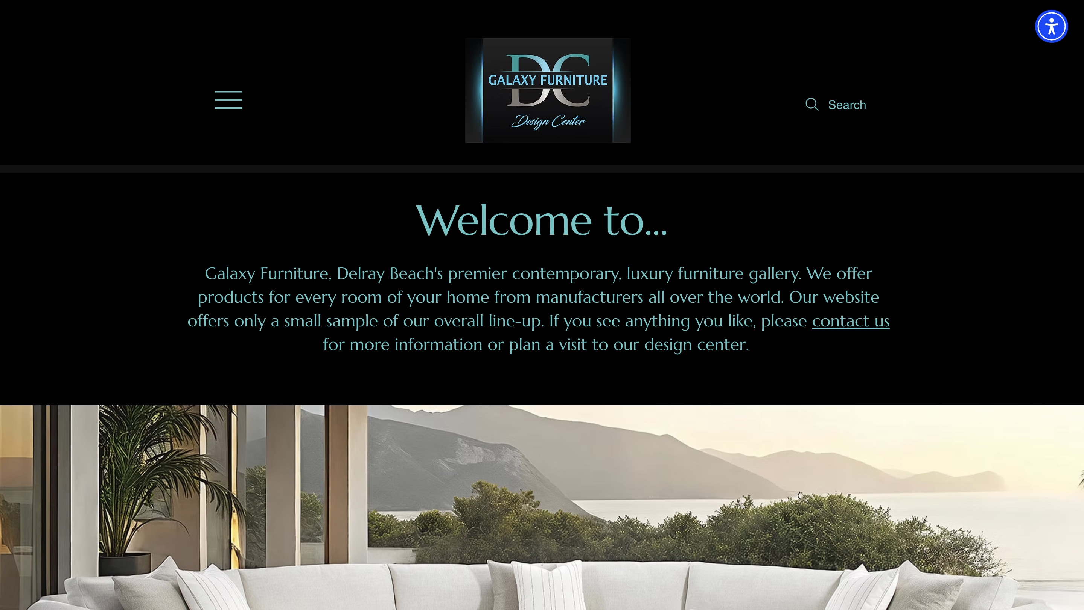
GALAXY FURNITURE · WEBSITE CONVERSATION
A clearer path from interest to inquiry
What I noticed
The introduction precedes much of the imagery. Lead with a room story and a clear consultation action; also correct the contact-email link.
Current website · desktop capture
Private discussion concept · Ravi Mehta · 17 October 2026
01
Notes:
Observed website screenshot captured October17,2026. https://www.galaxydesigncenter.com/
https://www.galaxydesigncenter.com/contact
The reviewed contact page displays a business email but links it to a placeholder email address.
No form or conversion failure claimed. Existing SEO and marketing vendor unknown. Sources: https://www.galaxydesigncenter.com/
https://www.galaxydesigncenter.com/contact
https://reviews.birdeye.com/galaxy-furniture-design-center-171671772649452
https://www.loc8nearme.com/florida/delray-beach/galaxy-furniture-design-center/9688795/

Slide 2
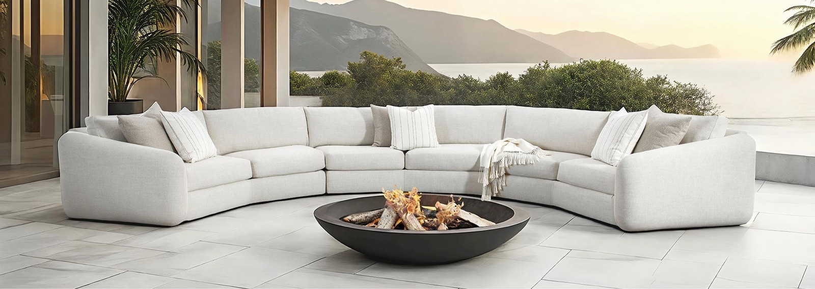
GALAXY FURNITURE · PROPOSED DIRECTION
A small concept, built around your business
Make room
for your life.
Furniture and design services in Delray Beach. Start with a room, a feeling, or a piece that brings it all together.
Explore a room consultation →
Published business imagery + proposed copy · Open the interactive homepage concept from the pack
Private discussion concept · Ravi Mehta · 17 October 2026
02
Notes:
Independent private homepage concept. Not a complete production website. Forms neither send nor store data. Source assets: https://www.galaxydesigncenter.com/. No client endorsement implied. Local demo folder: galaxy-furniture. Opportunity: Fix the contact path and guide interested visitors from specific rooms or collections toward a showroom consultation.

Slide 3
GALAXY FURNITURE · SEARCH DISCUSSION
Search evidence and a focused starting point
OBSERVED IN AHREFS
THREE IDEAS TO VALIDATE
#1
galaxy furniture delray
contemporary furniture Delray Beach
Last checked 2026-09-12
#1
galaxy furniture delray beach
furniture showroom Delray Beach
Last checked 2026-10-13
#3
galaxy furniture
interior design consultation Delray Beach
Last checked 2026-09-28
Choose by service fit, profit potential and capacity—not ranking alone.
US organic database; selected best positions. Not a live local map grid or AI-search ranking report.
Private discussion concept · Ravi Mehta · 17 October 2026
03
Notes:
Ahrefs Site Explorer organic keywords: target www.galaxydesigncenter.com, US, date2026-10-17, limit5, orderbest_positionasc. Sample and dated rows stored in ahrefs.json. Ahrefs reports position 1 for two Galaxy-plus-Delray brand searches and 3 for “galaxy furniture”; this is strong branded visibility, while non-brand showroom demand is untested in this small sample.
Keyword ideas are hypotheses, not verified demand or measured ranks. Map/AI visibility not measured. No improvement guarantee.

Slide 4
REPUTABLE SEO MARKETING · PUBLISHED CASE STUDY
A separate example of what measured work can do
MONTHLY WEBSITE INQUIRIES
An unnamed pool remodeler
Reputable SEO Marketing reports growth from 1 to 28 monthly website inquiries over six months.
The engagement included website redesign, SEO and a separate social campaign. This is the agency’s reported result, not a forecast for your business.
Source: reputableseomarketing.com · Calendar dates and underlying analytics are not supplied.
Private discussion concept · Ravi Mehta · 17 October 2026
04
Notes:
Source https://reputableseomarketing.com/ , CaseStudy1, accessedOctober17,2026. Published agency self-report, not independently audited. Anonymous client; no verified calendar dates. Numbers:1 and28 website inquiries per month after6months. Separate social15leads not included. Do not imply solely SEO attribution, own Ravi result, guaranteed prospect result or client identity. Confirm approved current evidence with Danny before using as a verified partner case. Draft request is included in pack. Ravi website portfolio: https://www.builderseastfl.com/ — design/build proof, no validated SEO lift claimed.

Slide 5
GALAXY FURNITURE · NEXT CONVERSATION
Start with the work you actually want more of.
Are you looking for more whole-room design consultations or sales from particular furniture collections?
A focused project, quoted after discovery
Relevant work to review
Agree on the service, geography, inquiry quality and available capacity. Then define the website or search work, tracking and review date.
Builder’s East
builderseastfl.com
Ravi’s web-development portfolio. SEO outcomes are separate and must be supported by their own evidence.
Private discussion concept · Ravi Mehta · 17 October 2026
05
Notes:
Your showroom already has strong branded search visibility. I spotted a contact-link detail and have an idea for helping collection browsers request a consultation.
Are you looking for more whole-room design consultations or sales from particular furniture collections?
Fix the contact path and guide interested visitors from specific rooms or collections toward a showroom consultation.
Proposed $500 scope is seller offer, not buyer budget or consent. No promises of leads or rankings. Build only after agreement and approval of business details. SEO decision: estimate contribution per job, close rate, capacity and acceptable acquisition cost; gross revenue is not profit. Public portfolio https://www.builderseastfl.com/ .

