Slide 1

ISLAND AIR · WEBSITE CONVERSATION
A clearer path from interest to inquiry
What I noticed
The current site already promotes replacement estimates. Test a more focused homeowner brief only if the team wants a different mix of inquiries.
Current website · desktop capture
Private discussion concept · Ravi Mehta · 17 October 2026
01
Notes:
Observed website screenshot captured October17,2026. https://www.islandairconditioning.com/
https://www.islandairconditioning.com/
The reviewed homepage presents repair and replacement services together through a broad, phone-led contact journey.
No form or conversion failure claimed. Existing SEO and marketing vendor unknown. Sources: https://www.islandairconditioning.com/
https://location.com/categories/contractors/us/fl/delray-beach/island-air-conditioning-242456745

Slide 2
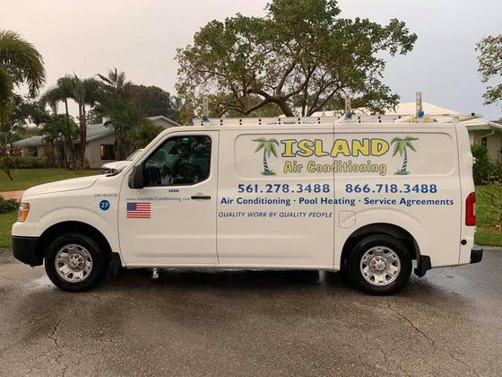
ISLAND AIR · PROPOSED DIRECTION
A small concept, built around your business
Comfort starts
with a clear plan.
Thinking about replacing your air conditioner? Tell Island Air what is happening at home and explore the next step.
Explore replacement options →
Published business imagery + proposed copy · Open the interactive homepage concept from the pack
Private discussion concept · Ravi Mehta · 17 October 2026
02
Notes:
Independent private homepage concept. Not a complete production website. Forms neither send nor store data. Source assets: https://www.islandairconditioning.com/. No client endorsement implied. Local demo folder: island-air. Opportunity: Keep existing search strengths and test a dedicated replacement-estimate path that helps homeowners explain their needs.

Slide 3
ISLAND AIR · SEARCH DISCUSSION
Search evidence and a focused starting point
OBSERVED IN AHREFS
THREE IDEAS TO VALIDATE
#1
island ac
AC replacement Delray Beach
Last checked 2026-09-23
#1
ac repair delray beach
air conditioning installation Boca Raton
Last checked 2026-10-14
#1
air conditioner repair delray beach
HVAC maintenance Delray Beach
Last checked 2026-10-15
Choose by service fit, profit potential and capacity—not ranking alone.
US organic database; selected best positions. Not a live local map grid or AI-search ranking report.
Private discussion concept · Ravi Mehta · 17 October 2026
03
Notes:
Ahrefs Site Explorer organic keywords: target www.islandairconditioning.com, US, date2026-10-17, limit5, orderbest_positionasc. Sample and dated rows stored in ahrefs.json. Ahrefs reports position 1 for “ac repair delray beach,” “air conditioner repair delray beach” and “ac service delray beach”; these checks show strong existing service visibility, so the proposal should focus on inquiry quality and conversion.
Keyword ideas are hypotheses, not verified demand or measured ranks. Map/AI visibility not measured. No improvement guarantee.

Slide 4
REPUTABLE SEO MARKETING · PUBLISHED CASE STUDY
A separate example of what measured work can do
MONTHLY WEBSITE INQUIRIES
An unnamed pool remodeler
Reputable SEO Marketing reports growth from 1 to 28 monthly website inquiries over six months.
The engagement included website redesign, SEO and a separate social campaign. This is the agency’s reported result, not a forecast for your business.
Source: reputableseomarketing.com · Calendar dates and underlying analytics are not supplied.
Private discussion concept · Ravi Mehta · 17 October 2026
04
Notes:
Source https://reputableseomarketing.com/ , CaseStudy1, accessedOctober17,2026. Published agency self-report, not independently audited. Anonymous client; no verified calendar dates. Numbers:1 and28 website inquiries per month after6months. Separate social15leads not included. Do not imply solely SEO attribution, own Ravi result, guaranteed prospect result or client identity. Confirm approved current evidence with Danny before using as a verified partner case. Draft request is included in pack. Ravi website portfolio: https://www.builderseastfl.com/ — design/build proof, no validated SEO lift claimed.

Slide 5
ISLAND AIR · NEXT CONVERSATION
Start with the work you actually want more of.
Would more planned replacement inquiries help, and how do you currently qualify them?
A focused project, quoted after discovery
Relevant work to review
Agree on the service, geography, inquiry quality and available capacity. Then define the website or search work, tracking and review date.
Builder’s East
builderseastfl.com
Ravi’s web-development portfolio. SEO outcomes are separate and must be supported by their own evidence.
Private discussion concept · Ravi Mehta · 17 October 2026
05
Notes:
You already have strong AC-repair search visibility. My idea is a focused replacement-estimate page that complements what is working.
Would more planned replacement inquiries help, and how do you currently qualify them?
Keep existing search strengths and test a dedicated replacement-estimate path that helps homeowners explain their needs.
Proposed $500 scope is seller offer, not buyer budget or consent. No promises of leads or rankings. Build only after agreement and approval of business details. SEO decision: estimate contribution per job, close rate, capacity and acceptable acquisition cost; gross revenue is not profit. Public portfolio https://www.builderseastfl.com/ .

