Slide 1
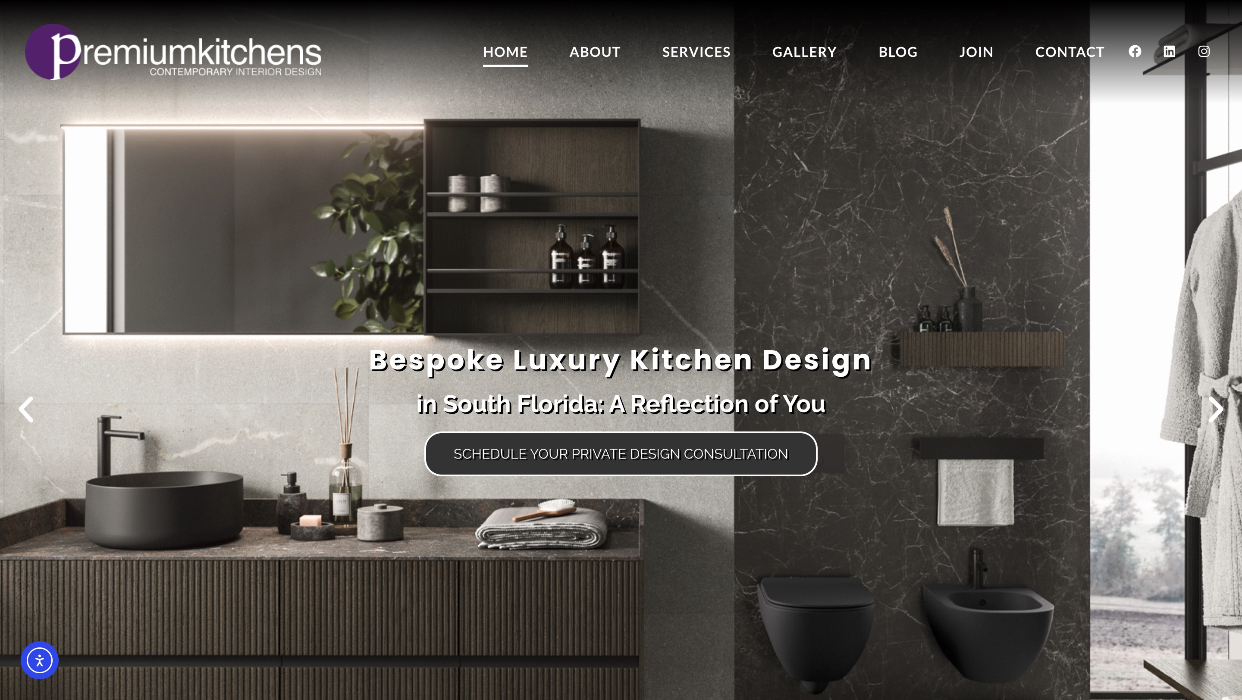
PREMIUM KITCHENS · WEBSITE CONVERSATION
A clearer path from interest to inquiry
What I noticed
The current site already has a polished portfolio and consultation action. Explore one local project campaign only if it serves an unmet goal.
Current website · desktop capture
Private discussion concept · Ravi Mehta · 17 October 2026
01
Notes:
Observed website screenshot captured October17,2026. https://premiumkitchens.com/
https://premiumkitchens.com/
The reviewed homepage sends different project categories toward a broad consultation path; no material website defect was established.
No form or conversion failure claimed. Existing SEO and marketing vendor unknown. Sources: https://premiumkitchens.com/
https://premiumkitchens.com/contact-us/boca-raton/
https://www.houzz.com/professionals/kitchen-and-bath-designers/premium-kitchens-pfvwus-pf~1988636280

Slide 2
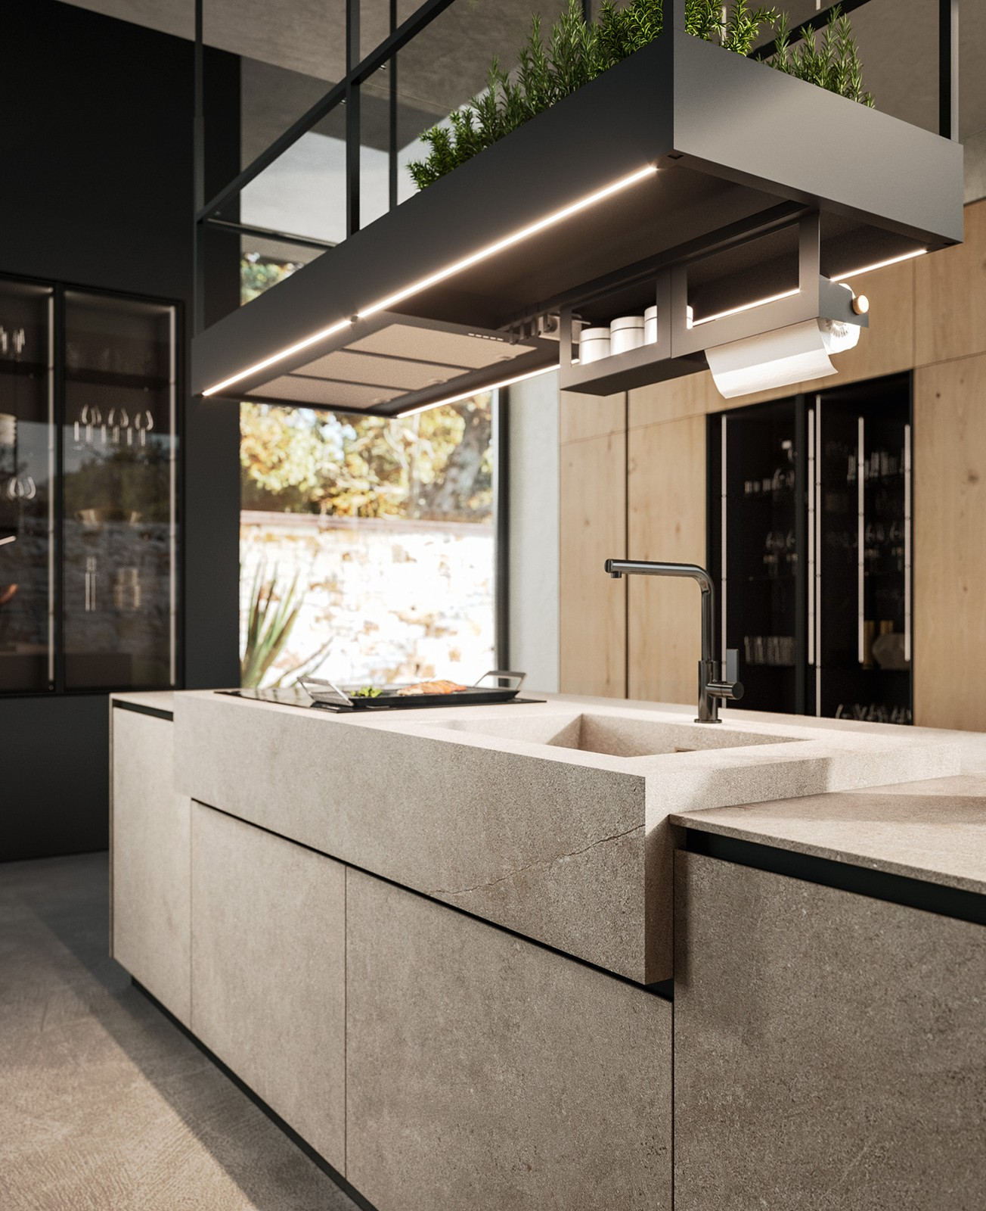
PREMIUM KITCHENS · PROPOSED DIRECTION
A small concept, built around your business
A kitchen that
feels like you.
Contemporary kitchen design in Boca Raton. Begin with the way you live, then consider the space that brings it together.
Explore your design brief →
Published business imagery + proposed copy · Open the interactive homepage concept from the pack
Private discussion concept · Ravi Mehta · 17 October 2026
02
Notes:
Independent private homepage concept. Not a complete production website. Forms neither send nor store data. Source assets: https://premiumkitchens.com/. No client endorsement implied. Local demo folder: premium-kitchens. Opportunity: Test a focused Boca project story and consultation page only if it supports a specific unmet marketing goal.

Slide 3
PREMIUM KITCHENS · SEARCH DISCUSSION
Search evidence and a focused starting point
OBSERVED IN AHREFS
THREE IDEAS TO VALIDATE
#1
premium kitchens boca raton
luxury kitchen design Boca Raton
Last checked 2026-09-02
#1
premium kitchens
Italian kitchen cabinets Boca Raton
Last checked 2026-08-23
#8
italian kitchen cabinets fort lauderdale
custom kitchen design Delray Beach
Last checked 2026-10-03
Choose by service fit, profit potential and capacity—not ranking alone.
US organic database; selected best positions. Not a live local map grid or AI-search ranking report.
Private discussion concept · Ravi Mehta · 17 October 2026
03
Notes:
Ahrefs Site Explorer organic keywords: target premiumkitchens.com, US, date2026-10-17, limit5, orderbest_positionasc. Sample and dated rows stored in ahrefs.json. Ahrefs reports position 1 for Premium Kitchens brand searches,8 for “italian kitchen cabinets fort lauderdale” and 9 for “kitchen remodeling ft. lauderdale”; existing visibility is evident, while Boca non-brand performance needs separate validation.
Keyword ideas are hypotheses, not verified demand or measured ranks. Map/AI visibility not measured. No improvement guarantee.

Slide 4
REPUTABLE SEO MARKETING · PUBLISHED CASE STUDY
A separate example of what measured work can do
MONTHLY WEBSITE INQUIRIES
An unnamed pool remodeler
Reputable SEO Marketing reports growth from 1 to 28 monthly website inquiries over six months.
The engagement included website redesign, SEO and a separate social campaign. This is the agency’s reported result, not a forecast for your business.
Source: reputableseomarketing.com · Calendar dates and underlying analytics are not supplied.
Private discussion concept · Ravi Mehta · 17 October 2026
04
Notes:
Source https://reputableseomarketing.com/ , CaseStudy1, accessedOctober17,2026. Published agency self-report, not independently audited. Anonymous client; no verified calendar dates. Numbers:1 and28 website inquiries per month after6months. Separate social15leads not included. Do not imply solely SEO attribution, own Ravi result, guaranteed prospect result or client identity. Confirm approved current evidence with Danny before using as a verified partner case. Draft request is included in pack. Ravi website portfolio: https://www.builderseastfl.com/ — design/build proof, no validated SEO lift claimed.

Slide 5
PREMIUM KITCHENS · NEXT CONVERSATION
Start with the work you actually want more of.
Which Boca or Delray project types would you most like additional consultations for?
A focused project, quoted after discovery
Relevant work to review
Agree on the service, geography, inquiry quality and available capacity. Then define the website or search work, tracking and review date.
Builder’s East
builderseastfl.com
Ravi’s web-development portfolio. SEO outcomes are separate and must be supported by their own evidence.
Private discussion concept · Ravi Mehta · 17 October 2026
05
Notes:
Your portfolio and website are already substantial. I have an idea for a focused local project campaign, if there is a particular type of consultation you want more of.
Which Boca or Delray project types would you most like additional consultations for?
Test a focused Boca project story and consultation page only if it supports a specific unmet marketing goal.
Proposed $500 scope is seller offer, not buyer budget or consent. No promises of leads or rankings. Build only after agreement and approval of business details. SEO decision: estimate contribution per job, close rate, capacity and acceptable acquisition cost; gross revenue is not profit. Public portfolio https://www.builderseastfl.com/ .

