Slide 1
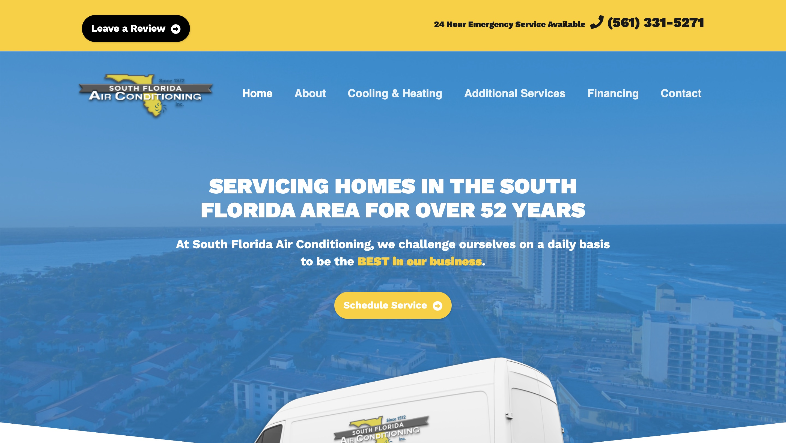
SOUTH FLORIDA AIR · WEBSITE CONVERSATION
A clearer path from interest to inquiry
What I noticed
The current site already has a clear service action. Explore a replacement-specific brief if that would improve inquiry quality for the team.
Current website · desktop capture
Private discussion concept · Ravi Mehta · 17 October 2026
01
Notes:
Observed website screenshot captured October17,2026. https://www.southfloridaair.com/
https://www.southfloridaair.com/
The reviewed homepage repeats long service-and-city headings.
No form or conversion failure claimed. Existing SEO and marketing vendor unknown. Sources: https://www.southfloridaair.com/
https://www.southfloridaair.com/contact-us/
https://reviews.birdeye.com/south-florida-air-conditioning-inc-165364142081779
https://www.carrier.com/us/en/residential/dealers/fl/boca-raton/3000-nw-2nd-ave-6609-loc/air-conditioner-repair-service

Slide 2
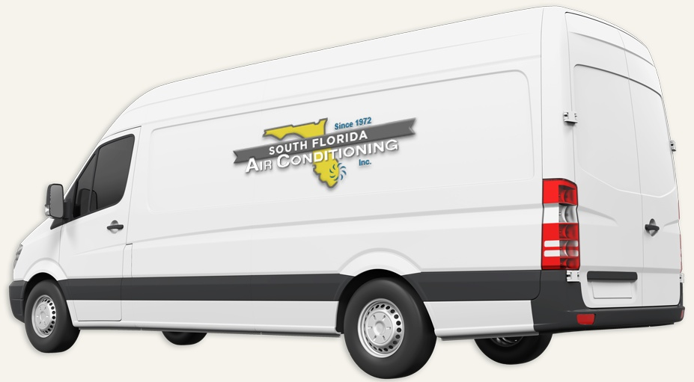
SOUTH FLORIDA AIR · PROPOSED DIRECTION
A small concept, built around your business
A better next step
for your home’s AC.
Repair, replacement and ongoing care in South Florida. Start with the problem you want to solve.
Explore an AC consultation →
Published business imagery + proposed copy · Open the interactive homepage concept from the pack
Private discussion concept · Ravi Mehta · 17 October 2026
02
Notes:
Independent private homepage concept. Not a complete production website. Forms neither send nor store data. Source assets: https://www.southfloridaair.com/. No client endorsement implied. Local demo folder: south-florida-air. Opportunity: Test a concise replacement consultation page while preserving the search visibility the current site already earns.

Slide 3
SOUTH FLORIDA AIR · SEARCH DISCUSSION
Search evidence and a focused starting point
OBSERVED IN AHREFS
THREE IDEAS TO VALIDATE
#1
south florida air
AC replacement Boca Raton
Last checked 2026-10-10
#1
south florida air conditioning
commercial HVAC Deerfield Beach
Last checked 2026-09-15
#2
air conditioning companies south florida
air conditioning installation Delray Beach
Last checked 2026-09-13
Choose by service fit, profit potential and capacity—not ranking alone.
US organic database; selected best positions. Not a live local map grid or AI-search ranking report.
Private discussion concept · Ravi Mehta · 17 October 2026
03
Notes:
Ahrefs Site Explorer organic keywords: target www.southfloridaair.com, US, date2026-10-17, limit5, orderbest_positionasc. Sample and dated rows stored in ahrefs.json. Ahrefs reports position 1 for two brand searches and 2 for regional terms including “air conditioning companies south florida” and “south florida ac repair”; this supports a focused conversion test, not a claim of weak SEO.
Keyword ideas are hypotheses, not verified demand or measured ranks. Map/AI visibility not measured. No improvement guarantee.

Slide 4
REPUTABLE SEO MARKETING · PUBLISHED CASE STUDY
A separate example of what measured work can do
MONTHLY WEBSITE INQUIRIES
An unnamed pool remodeler
Reputable SEO Marketing reports growth from 1 to 28 monthly website inquiries over six months.
The engagement included website redesign, SEO and a separate social campaign. This is the agency’s reported result, not a forecast for your business.
Source: reputableseomarketing.com · Calendar dates and underlying analytics are not supplied.
Private discussion concept · Ravi Mehta · 17 October 2026
04
Notes:
Source https://reputableseomarketing.com/ , CaseStudy1, accessedOctober17,2026. Published agency self-report, not independently audited. Anonymous client; no verified calendar dates. Numbers:1 and28 website inquiries per month after6months. Separate social15leads not included. Do not imply solely SEO attribution, own Ravi result, guaranteed prospect result or client identity. Confirm approved current evidence with Danny before using as a verified partner case. Draft request is included in pack. Ravi website portfolio: https://www.builderseastfl.com/ — design/build proof, no validated SEO lift claimed.

Slide 5
SOUTH FLORIDA AIR · NEXT CONVERSATION
Start with the work you actually want more of.
Are replacements, commercial jobs or maintenance agreements the best growth opportunity for your team?
A focused project, quoted after discovery
Relevant work to review
Agree on the service, geography, inquiry quality and available capacity. Then define the website or search work, tracking and review date.
Builder’s East
builderseastfl.com
Ravi’s web-development portfolio. SEO outcomes are separate and must be supported by their own evidence.
Private discussion concept · Ravi Mehta · 17 October 2026
05
Notes:
Your site already has strong regional search visibility. I have an idea for a shorter replacement inquiry page to test alongside it.
Are replacements, commercial jobs or maintenance agreements the best growth opportunity for your team?
Test a concise replacement consultation page while preserving the search visibility the current site already earns.
Proposed $500 scope is seller offer, not buyer budget or consent. No promises of leads or rankings. Build only after agreement and approval of business details. SEO decision: estimate contribution per job, close rate, capacity and acceptable acquisition cost; gross revenue is not profit. Public portfolio https://www.builderseastfl.com/ .

