Slide 1
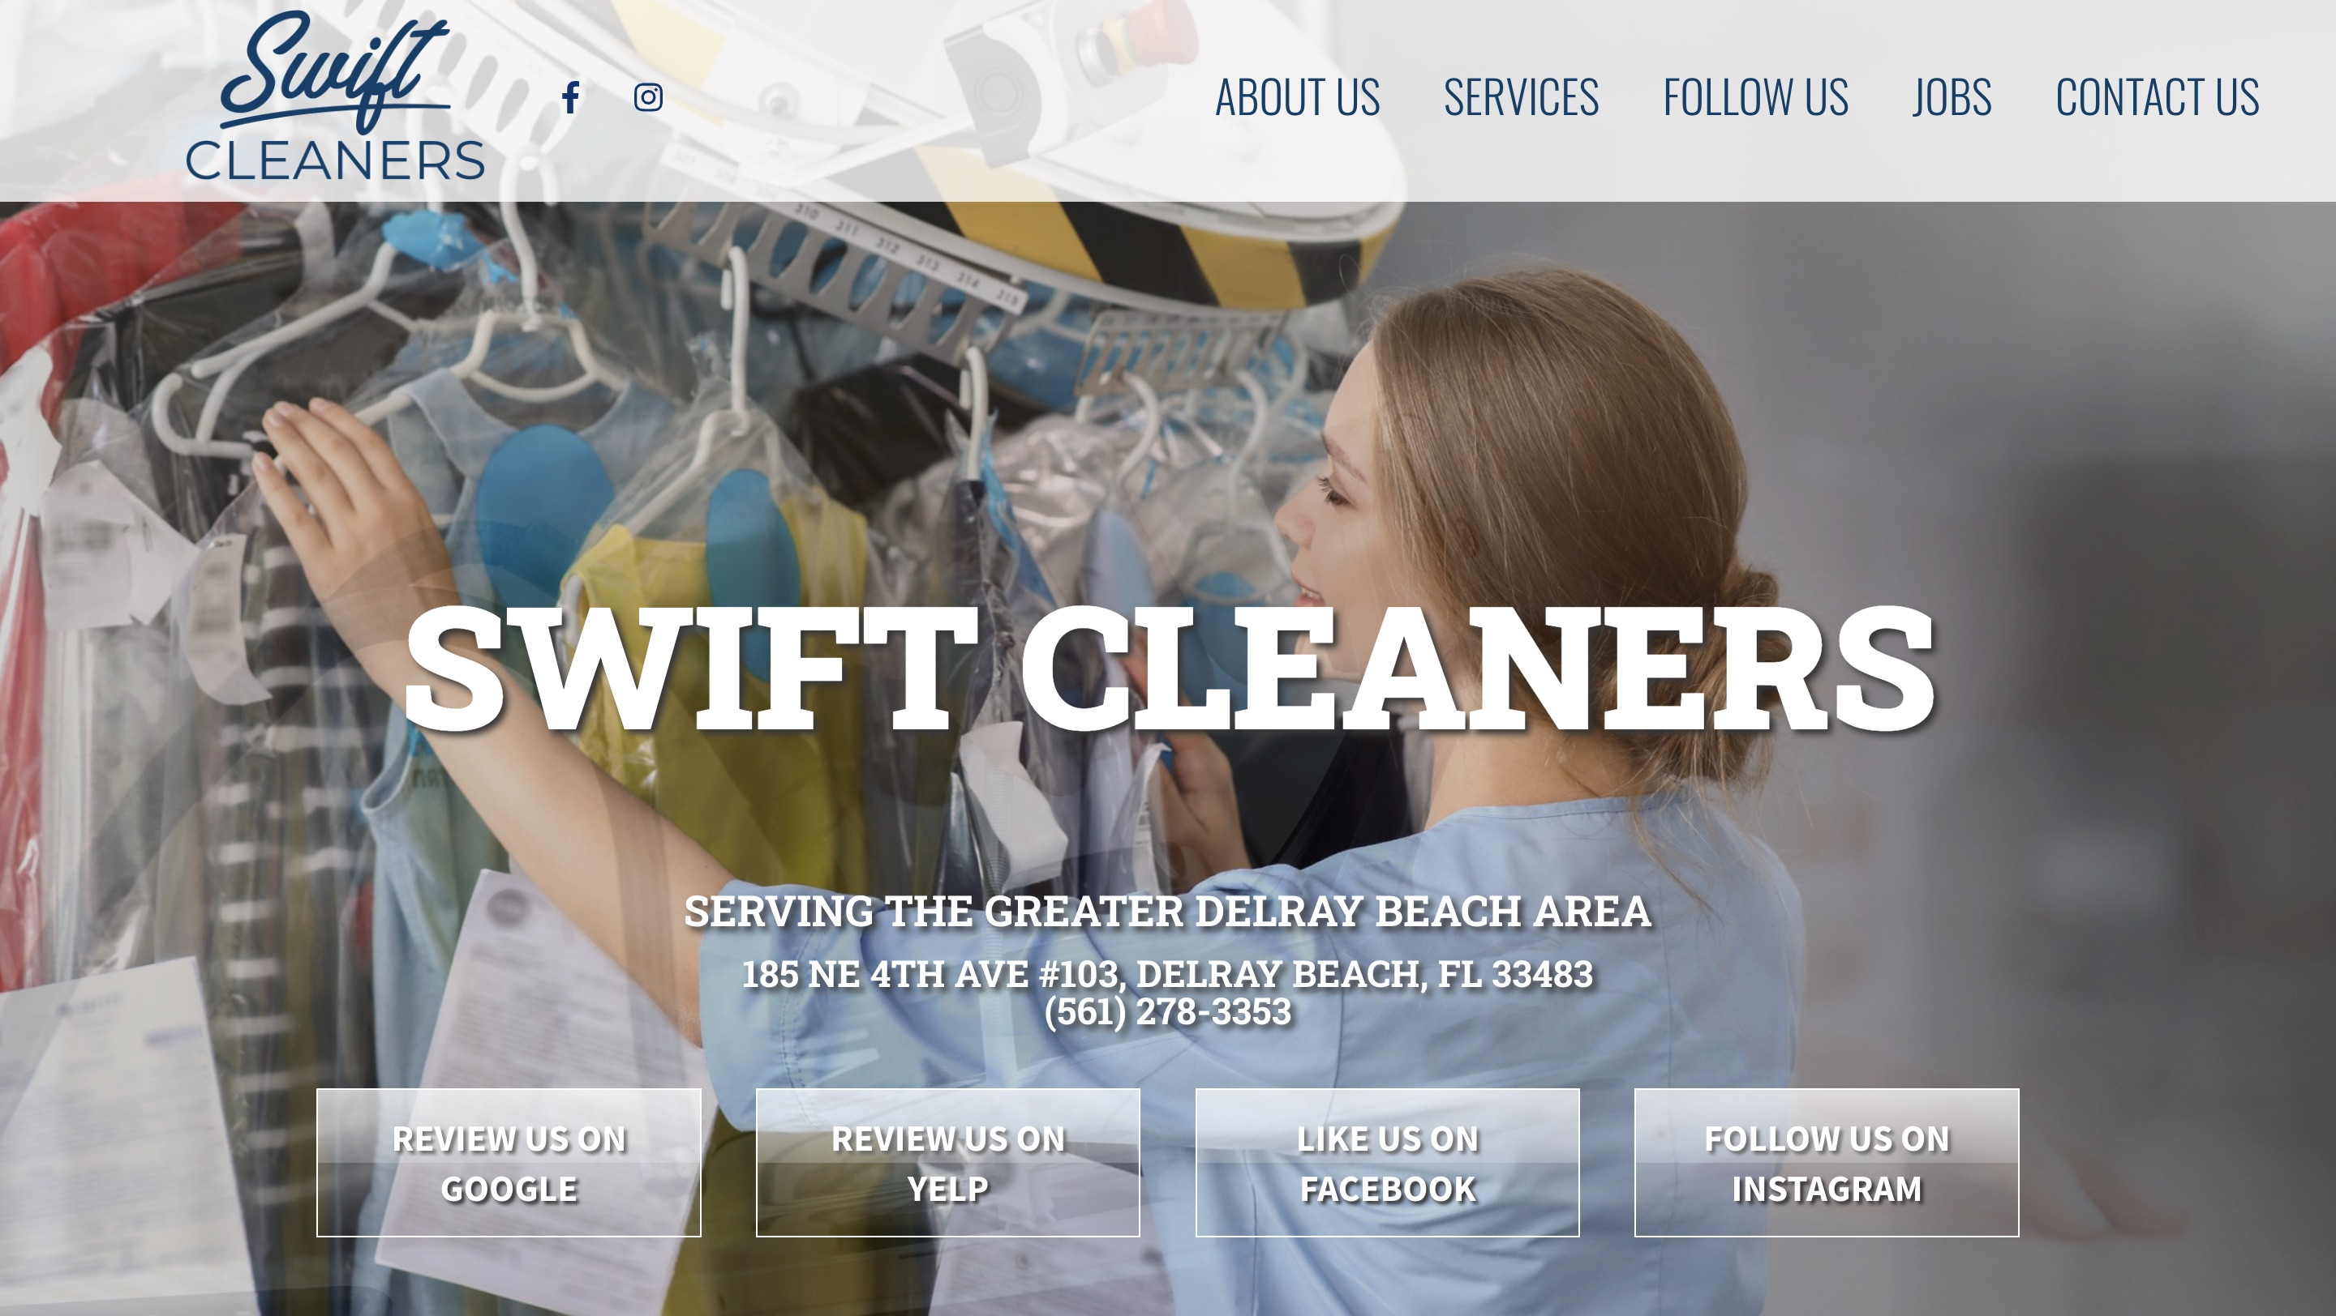
SWIFT CLEANERS · WEBSITE CONVERSATION
A clearer path from interest to inquiry
What I noticed
The opening prioritizes the address and social/review actions. A focused pickup-and-delivery path could make that existing service easier to request.
Current website · desktop capture
Private discussion concept · Ravi Mehta · 17 October 2026
01
Notes:
Observed website screenshot captured October17,2026. https://www.swiftcleanersdelray.com/
https://www.swiftcleanersdelray.com/contact-us/
The contact page publishes inconsistent hour blocks.
No form or conversion failure claimed. Existing SEO and marketing vendor unknown. Sources: https://www.swiftcleanersdelray.com/contact-us/
https://www.swiftcleanersdelray.com/about-us/
https://laundromatnear.me/place/swift-dry-cleaners-and-shoe-repair-delray-beach-fl-33483
https://www.superpages.com/delray-beach-fl/bpp/swift-cleaners-13759520

Slide 2

SWIFT CLEANERS · PROPOSED DIRECTION
A small concept, built around your business
Good care.
One less errand.
Dry cleaning, shoe repair and pickup & delivery in Delray Beach. A simple way to keep your week moving.
Explore pickup →
Published business imagery + proposed copy · Open the interactive homepage concept from the pack
Private discussion concept · Ravi Mehta · 17 October 2026
02
Notes:
Independent private homepage concept. Not a complete production website. Forms neither send nor store data. Source assets: https://www.swiftcleanersdelray.com/. No client endorsement implied. Local demo folder: swift-cleaners. Opportunity: Make hours consistent and give pickup-and-delivery customers a clearer request process.

Slide 3
SWIFT CLEANERS · SEARCH DISCUSSION
Search evidence and a focused starting point
OBSERVED IN AHREFS
THREE IDEAS TO VALIDATE
#4
shoe repair delray beach fl
dry cleaning pickup Delray Beach
Last checked 2026-09-15
shoe repair Delray Beach
wedding gown cleaning Delray Beach
Choose by service fit, profit potential and capacity—not ranking alone.
US organic database; selected best positions. Not a live local map grid or AI-search ranking report.
Private discussion concept · Ravi Mehta · 17 October 2026
03
Notes:
Ahrefs Site Explorer organic keywords: target www.swiftcleanersdelray.com, US, date2026-10-17, limit5, orderbest_positionasc. Sample and dated rows stored in ahrefs.json. Ahrefs reports position 4 for “shoe repair delray beach fl” from a September 15 check, evidence of existing visibility; the sample does not show how pickup-and-delivery searches perform.
Keyword ideas are hypotheses, not verified demand or measured ranks. Map/AI visibility not measured. No improvement guarantee.

Slide 4
REPUTABLE SEO MARKETING · PUBLISHED CASE STUDY
A separate example of what measured work can do
MONTHLY WEBSITE INQUIRIES
An unnamed pool remodeler
Reputable SEO Marketing reports growth from 1 to 28 monthly website inquiries over six months.
The engagement included website redesign, SEO and a separate social campaign. This is the agency’s reported result, not a forecast for your business.
Source: reputableseomarketing.com · Calendar dates and underlying analytics are not supplied.
Private discussion concept · Ravi Mehta · 17 October 2026
04
Notes:
Source https://reputableseomarketing.com/ , CaseStudy1, accessedOctober17,2026. Published agency self-report, not independently audited. Anonymous client; no verified calendar dates. Numbers:1 and28 website inquiries per month after6months. Separate social15leads not included. Do not imply solely SEO attribution, own Ravi result, guaranteed prospect result or client identity. Confirm approved current evidence with Danny before using as a verified partner case. Draft request is included in pack. Ravi website portfolio: https://www.builderseastfl.com/ — design/build proof, no validated SEO lift claimed.

Slide 5
SWIFT CLEANERS · NEXT CONVERSATION
Start small. Make the scope clear.
Would more pickup-and-delivery customers or in-store repair work be more valuable right now?
A $500 starter-page option
Relevant work to review
One responsive page, approved content and imagery, clear call/directions, and one revision. Hosting, domain, paid services and ongoing SEO quoted separately.
Builder’s East
builderseastfl.com
Ravi’s web-development portfolio. SEO outcomes are separate and must be supported by their own evidence.
Private discussion concept · Ravi Mehta · 17 October 2026
05
Notes:
You already have search visibility for shoe repair. I have an idea for making your pickup-and-delivery offer easier to act on.
Would more pickup-and-delivery customers or in-store repair work be more valuable right now?
Make hours consistent and give pickup-and-delivery customers a clearer request process.
Proposed $500 scope is seller offer, not buyer budget or consent. No promises of leads or rankings. Build only after agreement and approval of business details. SEO decision: estimate contribution per job, close rate, capacity and acceptable acquisition cost; gross revenue is not profit. Public portfolio https://www.builderseastfl.com/ .

