Slide 1

TROPICAL FLAMES · WEBSITE CONVERSATION
A clearer path from interest to inquiry
What I noticed
On our first visit, a newsletter popup covered the project message. Consider delaying that prompt and giving custom-installation visitors a focused path. The underlying site already has strong imagery and contact actions.
Current website · first-visit newsletter overlay shown
Private discussion concept · Ravi Mehta · 17 October 2026
01
Notes:
Observed website screenshot captured October17,2026. https://www.tropicalflames.com/
https://www.tropicalflames.com/
The reviewed homepage combines product specials and shopping with custom design-and-installation services in the same journey.
No form or conversion failure claimed. Existing SEO and marketing vendor unknown. Sources: https://www.tropicalflames.com/
https://www.tropicalflames.com/contact-us
https://www.tropicalflames.com/copy-of-outdoor-kitchens
https://www.houzz.com/professionals/fireplace/doral-fl-us-probr0-bo~t_11800~r_4153471

Slide 2
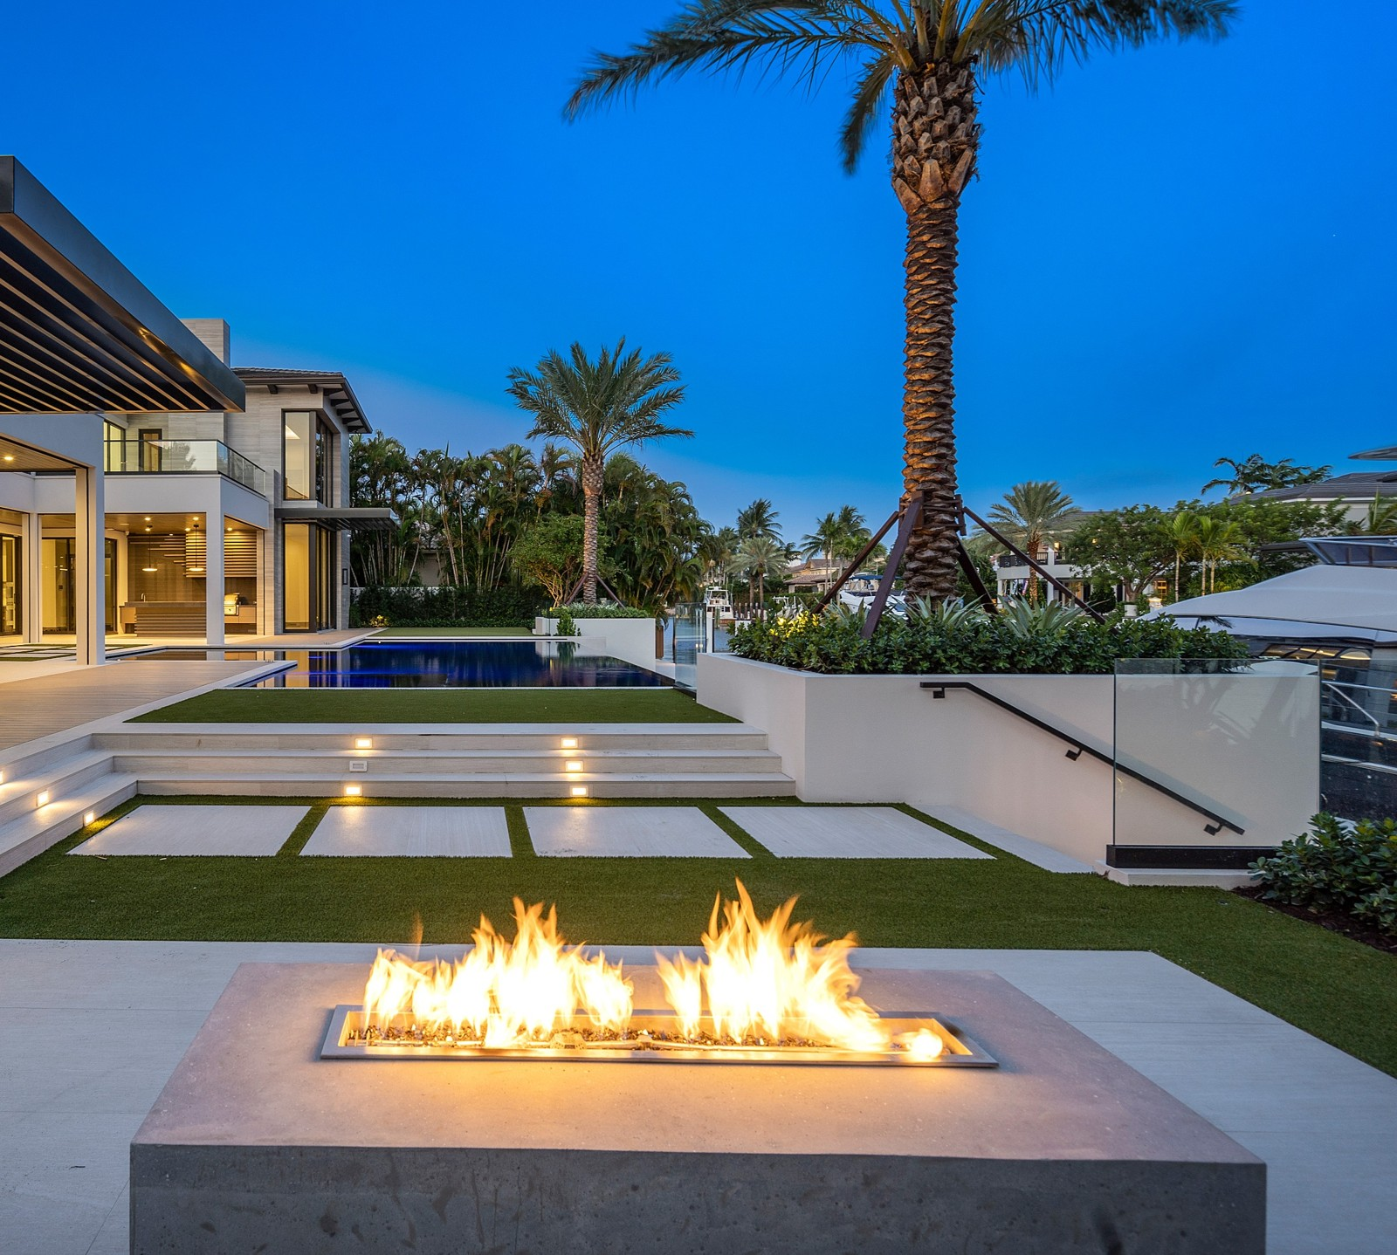
TROPICAL FLAMES · PROPOSED DIRECTION
A small concept, built around your business
The best room
is outside.
Custom outdoor kitchens, grills and fire features in Boca Raton. Turn a gathering space into a place you use every day.
Explore your outdoor project →
Published business imagery + proposed copy · Open the interactive homepage concept from the pack
Private discussion concept · Ravi Mehta · 17 October 2026
02
Notes:
Independent private homepage concept. Not a complete production website. Forms neither send nor store data. Source assets: https://www.tropicalflames.com/. No client endorsement implied. Local demo folder: tropical-flames. Opportunity: Give homeowners seeking an installed outdoor kitchen a dedicated consultation path using your actual local projects.

Slide 3
TROPICAL FLAMES · SEARCH DISCUSSION
Search evidence and a focused starting point
OBSERVED IN AHREFS
THREE IDEAS TO VALIDATE
#3
tropical flame
outdoor kitchen installation Boca Raton
Last checked 2026-09-15
#5
tropical outdoor kitchen
custom outdoor kitchens Delray Beach
Last checked 2026-09-15
#5
firepits near me
fireplace installation Boca Raton
Last checked 2026-10-08
Choose by service fit, profit potential and capacity—not ranking alone.
US organic database; selected best positions. Not a live local map grid or AI-search ranking report.
Private discussion concept · Ravi Mehta · 17 October 2026
03
Notes:
Ahrefs Site Explorer organic keywords: target www.tropicalflames.com, US, date2026-10-17, limit5, orderbest_positionasc. Sample and dated rows stored in ahrefs.json. Ahrefs reports position 3 for “tropical flame,”5 for “firepits near me,” and 6 for “outdoor kitchens boca raton”; useful existing visibility makes a focused consultation improvement more appropriate than an absent-SEO pitch.
Keyword ideas are hypotheses, not verified demand or measured ranks. Map/AI visibility not measured. No improvement guarantee.

Slide 4
REPUTABLE SEO MARKETING · PUBLISHED CASE STUDY
A separate example of what measured work can do
MONTHLY WEBSITE INQUIRIES
An unnamed pool remodeler
Reputable SEO Marketing reports growth from 1 to 28 monthly website inquiries over six months.
The engagement included website redesign, SEO and a separate social campaign. This is the agency’s reported result, not a forecast for your business.
Source: reputableseomarketing.com · Calendar dates and underlying analytics are not supplied.
Private discussion concept · Ravi Mehta · 17 October 2026
04
Notes:
Source https://reputableseomarketing.com/ , CaseStudy1, accessedOctober17,2026. Published agency self-report, not independently audited. Anonymous client; no verified calendar dates. Numbers:1 and28 website inquiries per month after6months. Separate social15leads not included. Do not imply solely SEO attribution, own Ravi result, guaranteed prospect result or client identity. Confirm approved current evidence with Danny before using as a verified partner case. Draft request is included in pack. Ravi website portfolio: https://www.builderseastfl.com/ — design/build proof, no validated SEO lift claimed.

Slide 5
TROPICAL FLAMES · NEXT CONVERSATION
Start with the work you actually want more of.
Are additional installed outdoor-kitchen projects a priority, and what makes an inquiry a good fit?
A focused project, quoted after discovery
Relevant work to review
Agree on the service, geography, inquiry quality and available capacity. Then define the website or search work, tracking and review date.
Builder’s East
builderseastfl.com
Ravi’s web-development portfolio. SEO outcomes are separate and must be supported by their own evidence.
Private discussion concept · Ravi Mehta · 17 October 2026
05
Notes:
You already appear for outdoor-kitchen searches. I have an idea for separating full installation inquiries from people shopping for individual products.
Are additional installed outdoor-kitchen projects a priority, and what makes an inquiry a good fit?
Give homeowners seeking an installed outdoor kitchen a dedicated consultation path using your actual local projects.
Proposed $500 scope is seller offer, not buyer budget or consent. No promises of leads or rankings. Build only after agreement and approval of business details. SEO decision: estimate contribution per job, close rate, capacity and acceptable acquisition cost; gross revenue is not profit. Public portfolio https://www.builderseastfl.com/ .

