Slide 1
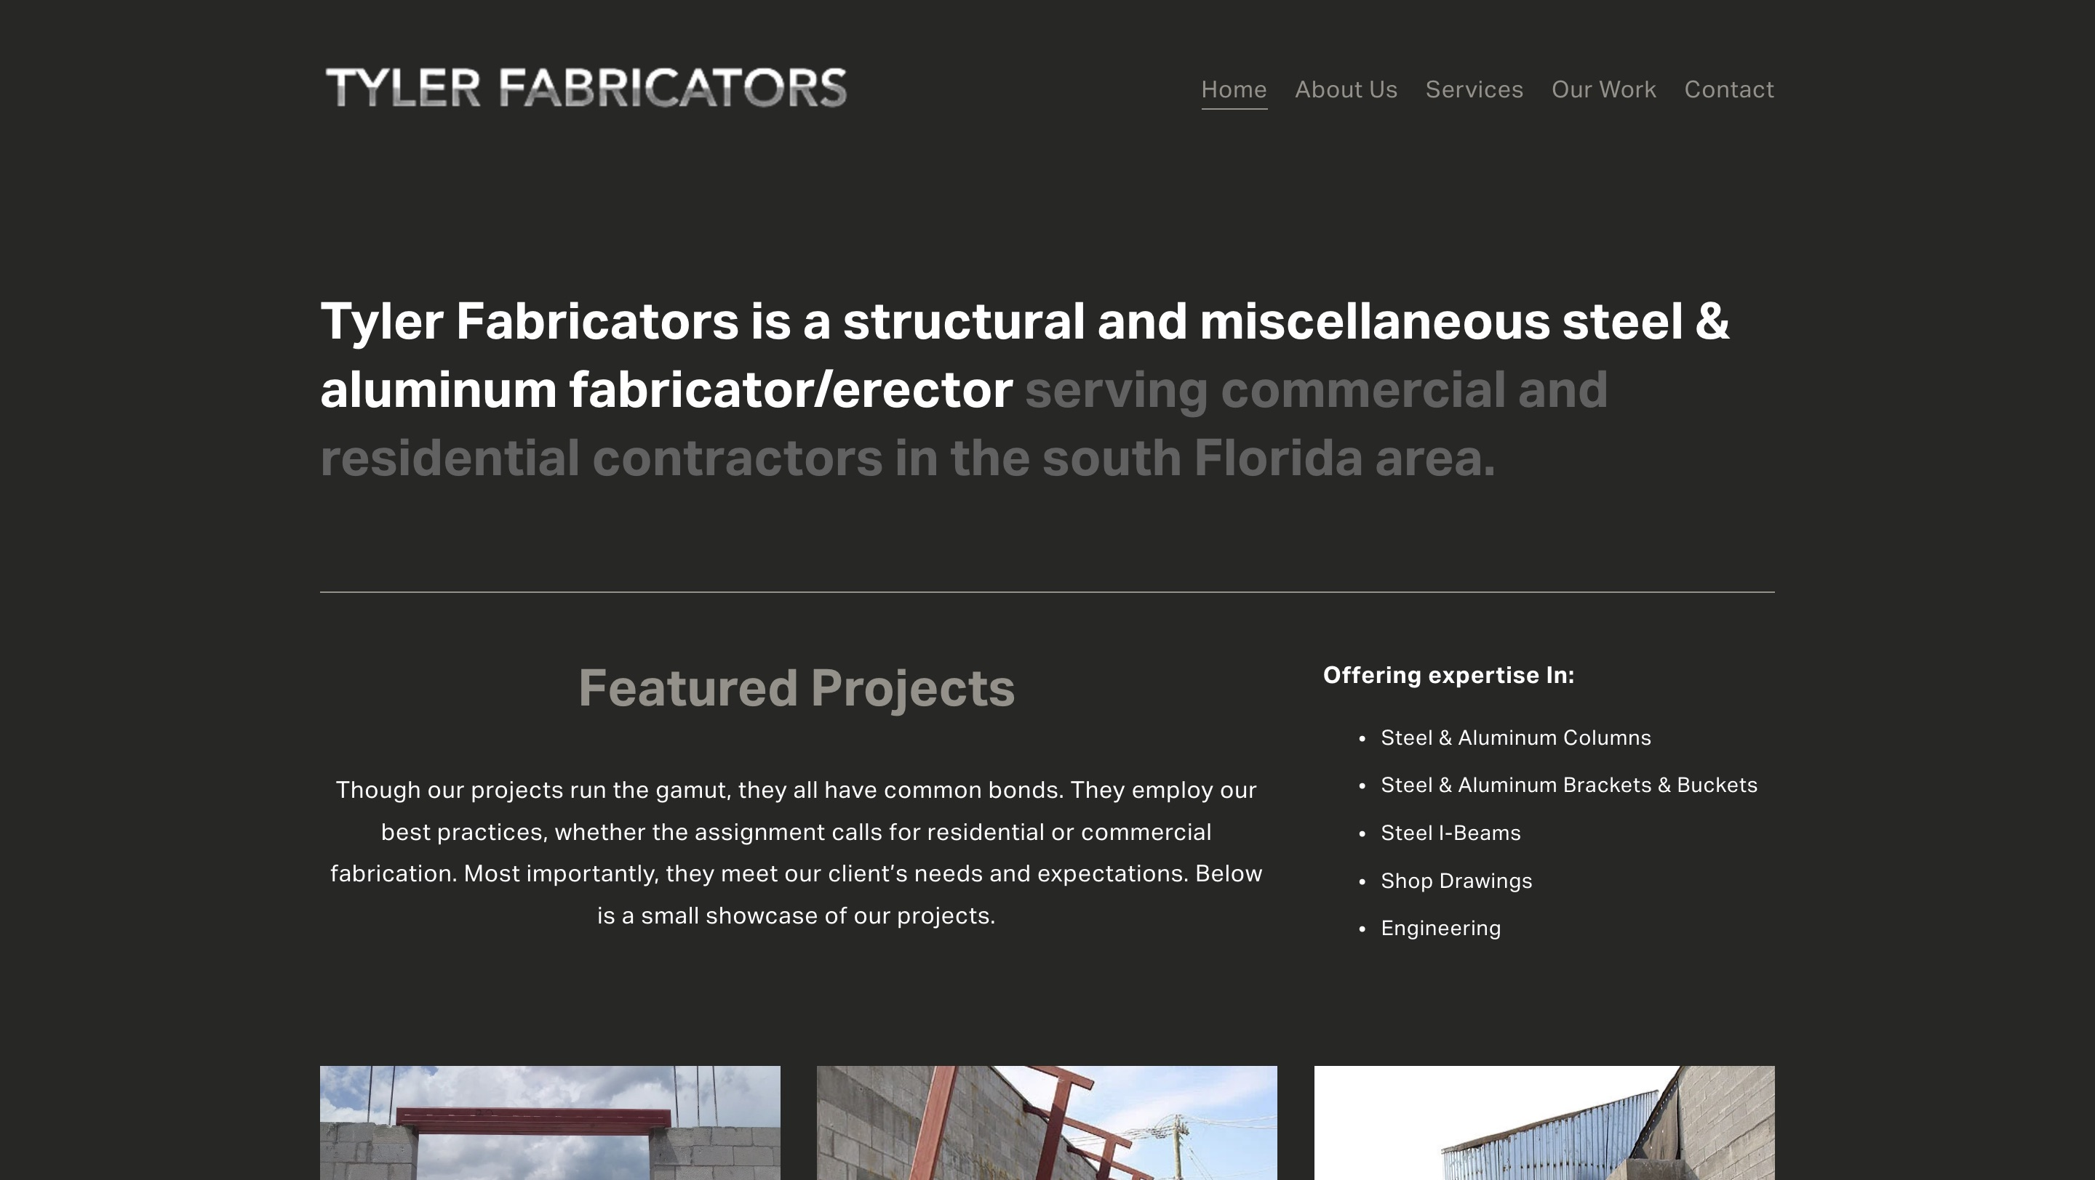
TYLER FABRICATORS · WEBSITE CONVERSATION
A clearer path from interest to inquiry
What I noticed
Your project photographs show the work. Bringing the inquiry action forward and explaining project scope could help contractors take the next step.
Current website · desktop capture
Private discussion concept · Ravi Mehta · 17 October 2026
01
Notes:
Observed website screenshot captured October17,2026. https://www.tylerfabricators.com/
https://www.tylerfabricators.com/work
The reviewed portfolio shows project photos with little project-specific explanation, while contact is primarily phone and email.
No form or conversion failure claimed. Existing SEO and marketing vendor unknown. Sources: https://www.tylerfabricators.com/
https://www.tylerfabricators.com/contact
https://www.tylerfabricators.com/work
https://reviews.birdeye.com/tyler-fabricators-148581160745188

Slide 2
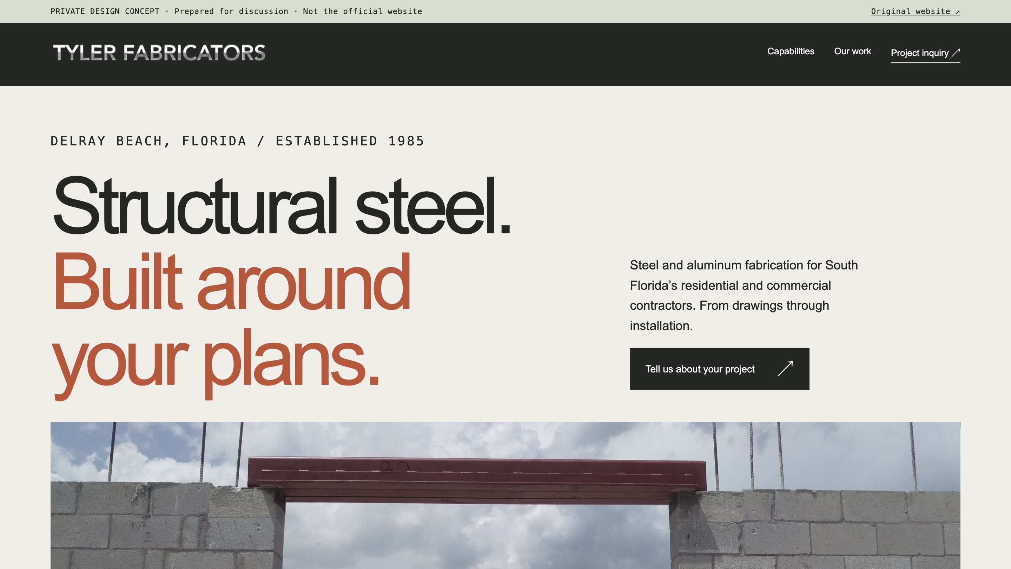
TYLER FABRICATORS · PROPOSED DIRECTION
A small concept, built around your business
Your identity and published imagery · One clear action · Private demonstration
Private discussion concept · Ravi Mehta · 17 October 2026
02
Notes:
Independent private homepage concept. Not a complete production website. Forms neither send nor store data. Source assets: https://www.tylerfabricators.com/. No client endorsement implied. Local demo folder: tyler. Opportunity: Explain the work behind the photos and make it easier for contractors to send the specifications needed for a useful bid.

Slide 3
TYLER FABRICATORS · SEARCH DISCUSSION
Search evidence and a focused starting point
OBSERVED IN AHREFS
THREE IDEAS TO VALIDATE
No keywords returned
in this small sample.
steel fabricators Delray Beach
structural steel fabrication Boca Raton
That is not proof of no rankings or traffic. Verify a local baseline before proposing an SEO scope.
aluminum fabrication Deerfield Beach
Choose by service fit, profit potential and capacity—not ranking alone.
US organic database; selected best positions. Not a live local map grid or AI-search ranking report.
Private discussion concept · Ravi Mehta · 17 October 2026
03
Notes:
Ahrefs Site Explorer organic keywords: target www.tylerfabricators.com, US, date2026-10-17, limit5, orderbest_positionasc. Sample and dated rows stored in ahrefs.json. This limited Ahrefs sample returned no keywords for Tyler; it does not establish zero rankings or traffic, so search visibility needs a fuller baseline before making an SEO pitch.
Keyword ideas are hypotheses, not verified demand or measured ranks. Map/AI visibility not measured. No improvement guarantee.

Slide 4
REPUTABLE SEO MARKETING · PUBLISHED CASE STUDY
A separate example of what measured work can do
MONTHLY WEBSITE INQUIRIES
An unnamed pool remodeler
Reputable SEO Marketing reports growth from 1 to 28 monthly website inquiries over six months.
The engagement included website redesign, SEO and a separate social campaign. This is the agency’s reported result, not a forecast for your business.
Source: reputableseomarketing.com · Calendar dates and underlying analytics are not supplied.
Private discussion concept · Ravi Mehta · 17 October 2026
04
Notes:
Source https://reputableseomarketing.com/ , CaseStudy1, accessedOctober17,2026. Published agency self-report, not independently audited. Anonymous client; no verified calendar dates. Numbers:1 and28 website inquiries per month after6months. Separate social15leads not included. Do not imply solely SEO attribution, own Ravi result, guaranteed prospect result or client identity. Confirm approved current evidence with Danny before using as a verified partner case. Draft request is included in pack. Ravi website portfolio: https://www.builderseastfl.com/ — design/build proof, no validated SEO lift claimed.

Slide 5
TYLER FABRICATORS · NEXT CONVERSATION
Start with the work you actually want more of.
Are you taking on additional jobs, and which fabrication projects would you most like to quote?
A focused project, quoted after discovery
Relevant work to review
Agree on the service, geography, inquiry quality and available capacity. Then define the website or search work, tracking and review date.
Builder’s East
builderseastfl.com
Ravi’s web-development portfolio. SEO outcomes are separate and must be supported by their own evidence.
Private discussion concept · Ravi Mehta · 17 October 2026
05
Notes:
Your steel-project photos caught my attention. I have an idea for presenting those capabilities and collecting better bid requests.
Are you taking on additional jobs, and which fabrication projects would you most like to quote?
Explain the work behind the photos and make it easier for contractors to send the specifications needed for a useful bid.
Proposed $500 scope is seller offer, not buyer budget or consent. No promises of leads or rankings. Build only after agreement and approval of business details. SEO decision: estimate contribution per job, close rate, capacity and acceptable acquisition cost; gross revenue is not profit. Public portfolio https://www.builderseastfl.com/ .

